Slide 1

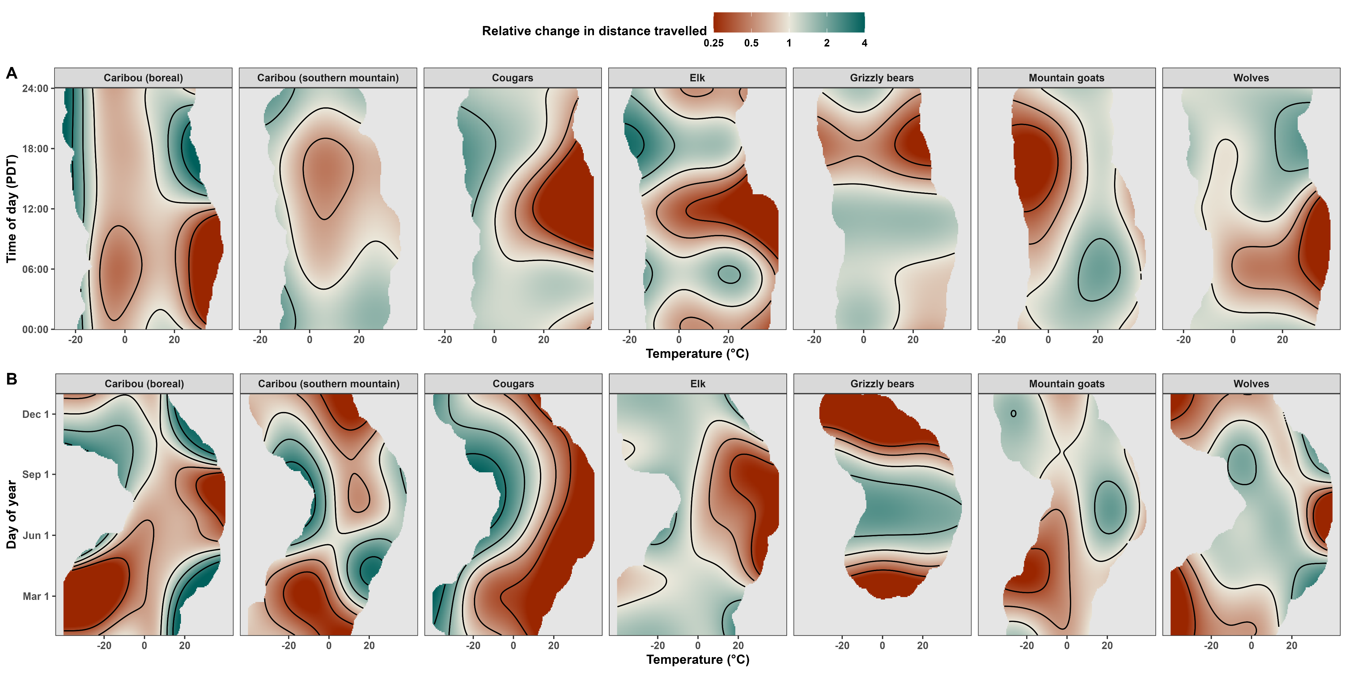
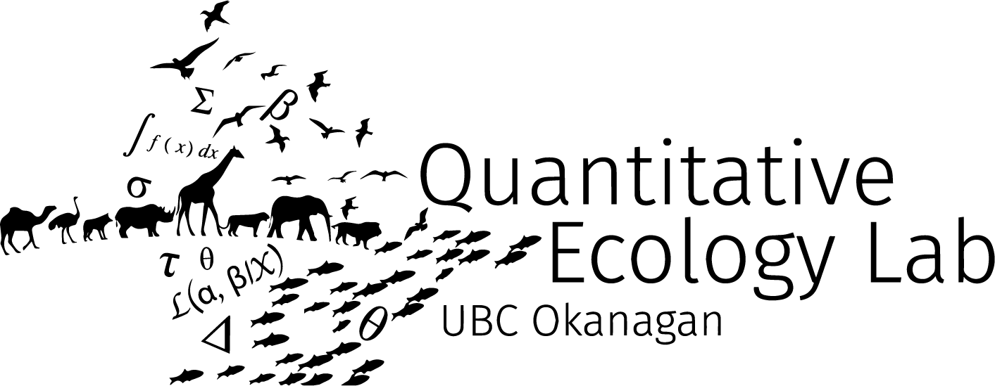

Rising temperatures alter how and where mammals move
Stefano Mezzini
Ph.D. Biology candidate

Slide 2
A bit of history…

Slide 3
The Land before Edmonton: Amiskwaciy
Amiskwaciy (Cree for “Beaver Hills”):
Inhabited by the Nehiyawak (Cree), Stoney Nakoda,
Niitsítpi (Blackfoot), Tsuut’ina, and Michif (Métis) Peoples
During late 1700s:
Was a coveted fur-trading location
Hudson's Bay Company built Fort Edmonton,
AKA Amiskwaciywâskahikan (“Beaver Hills House”)
Notes:
Amiskwaciy Wâskahikan:
Nehiyawak: https://youtu.be/mjTFh_AnYmY?si=aHFz0t2AFfP71XbN&t=13
Stoney Nakoda are also called Ĩyãħé Nakón mąkóce, but I couldn’t find a clear pronunciation of the name
Niitsítpi: /nit’si’tpi/ https://youtu.be/A0e6I6wKi9Q?si=pHiNdlrHEurcllrJ&t=16
Tsuut’ina: /tsuu-tèna/ https://youtu.be/iuoUF0n90iU?si=MlgeoB0_fII3lBVA&t=17
Michif: https://youtu.be/NxwL20Kf0YA?si=kAZ4o-otCz1-ju2B&t=245

Slide 4
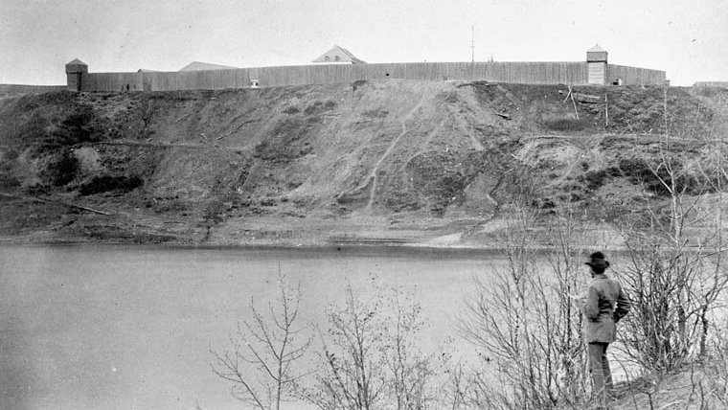
Photo of Fort Edmonton in 1870 by Charles Horetsky (1838-1900) from Library and Archives Canada (cropped).

Slide 5
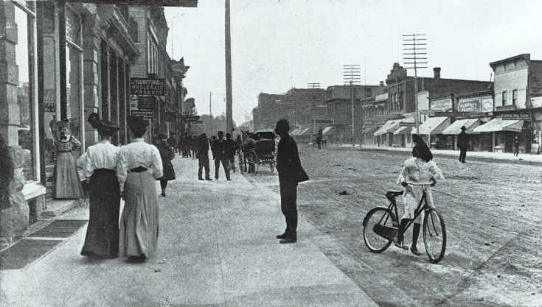
Jasper Ave circa 1910

Slide 6
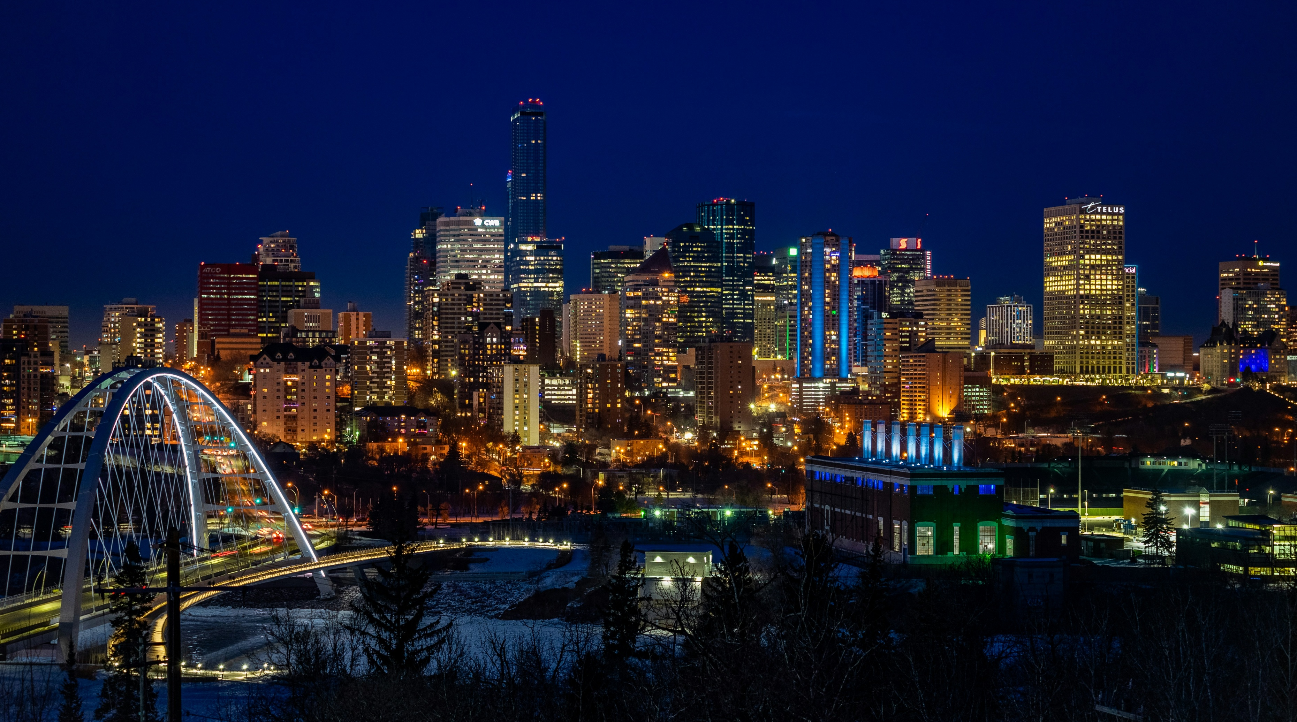
Photo of Edmonton by Justin Hu on Unsplash (cropped)

Slide 7
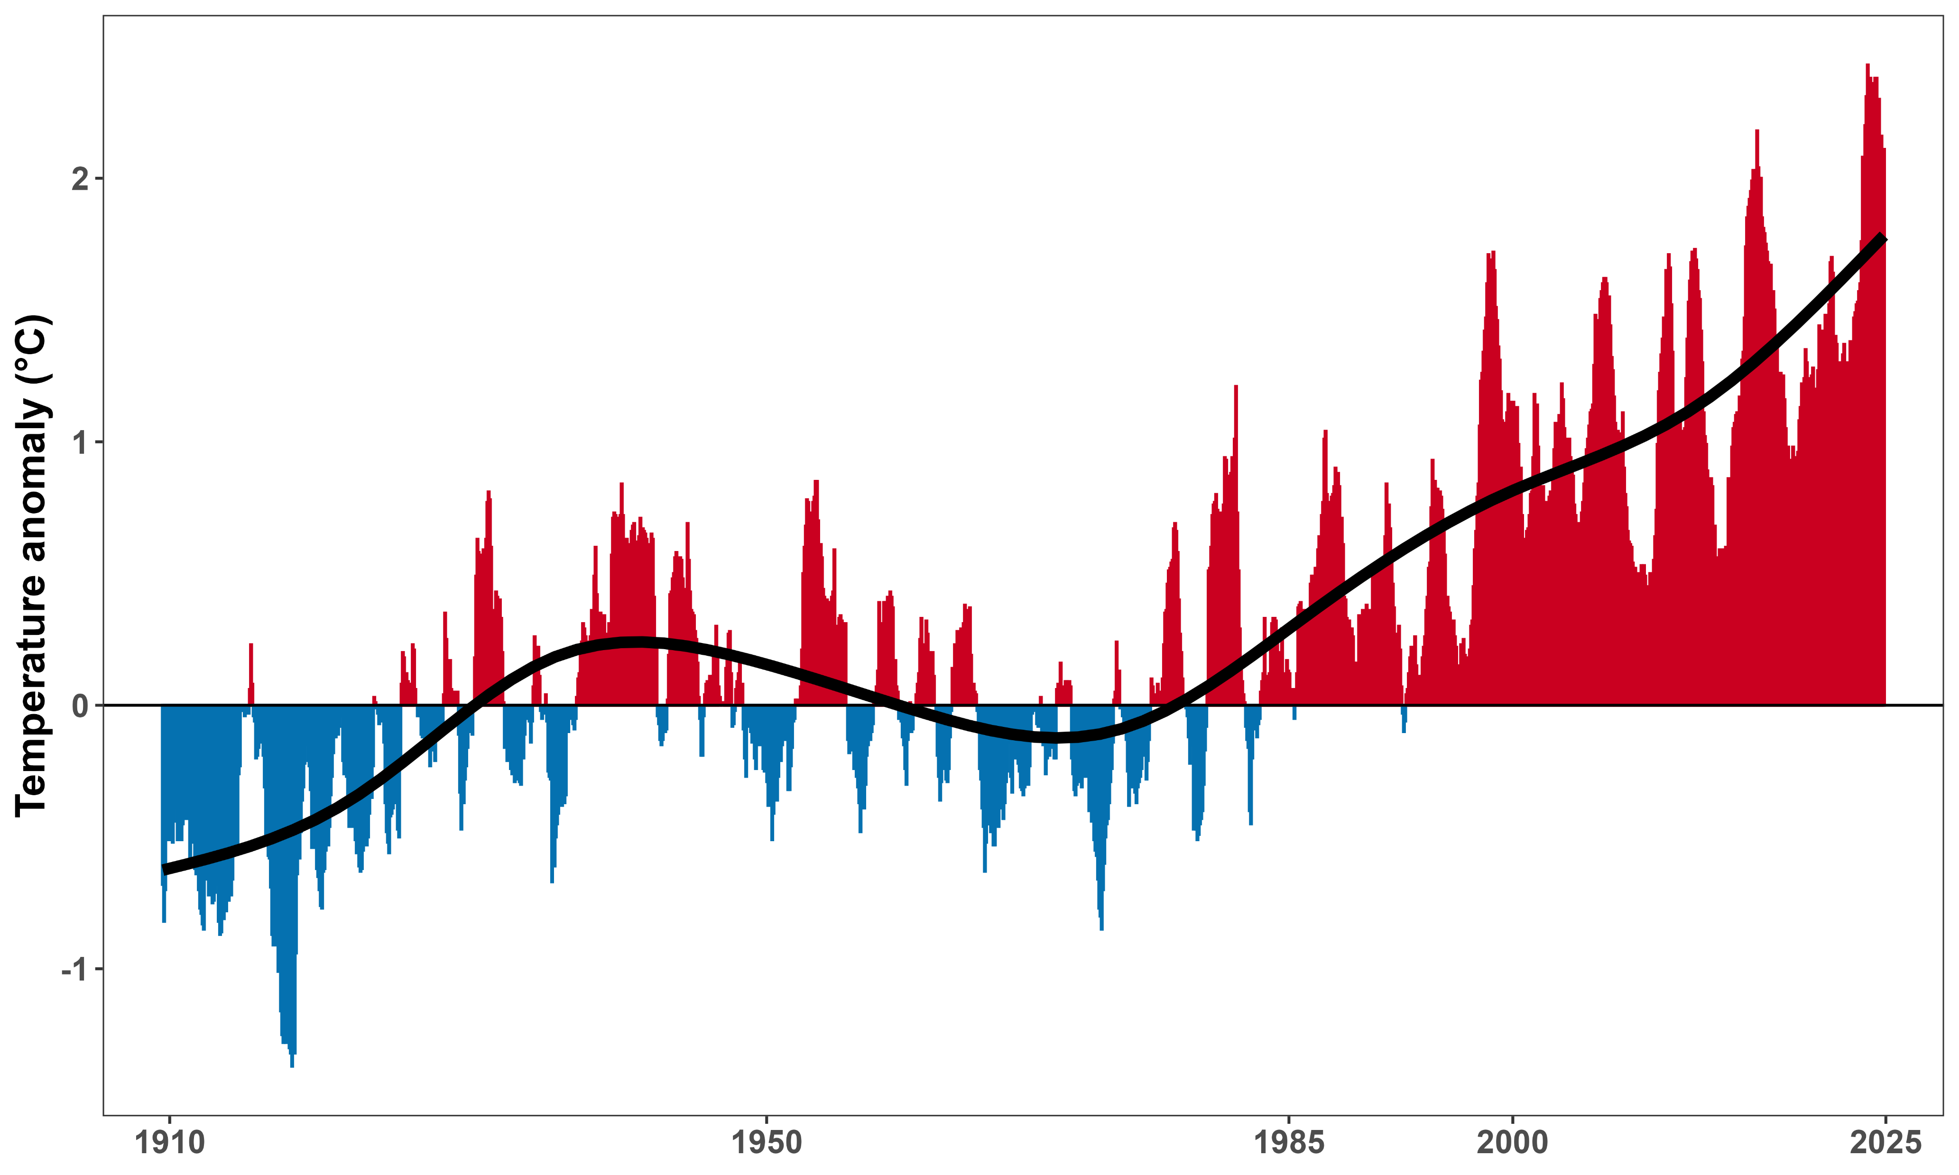

The climate warmed rapidly in the last 40 years
North American temperature anomaly, relative to the 1910-2000 average. Data source: NOAA
Notes:
Second highlight is 1985-2025: 40 years

Slide 8
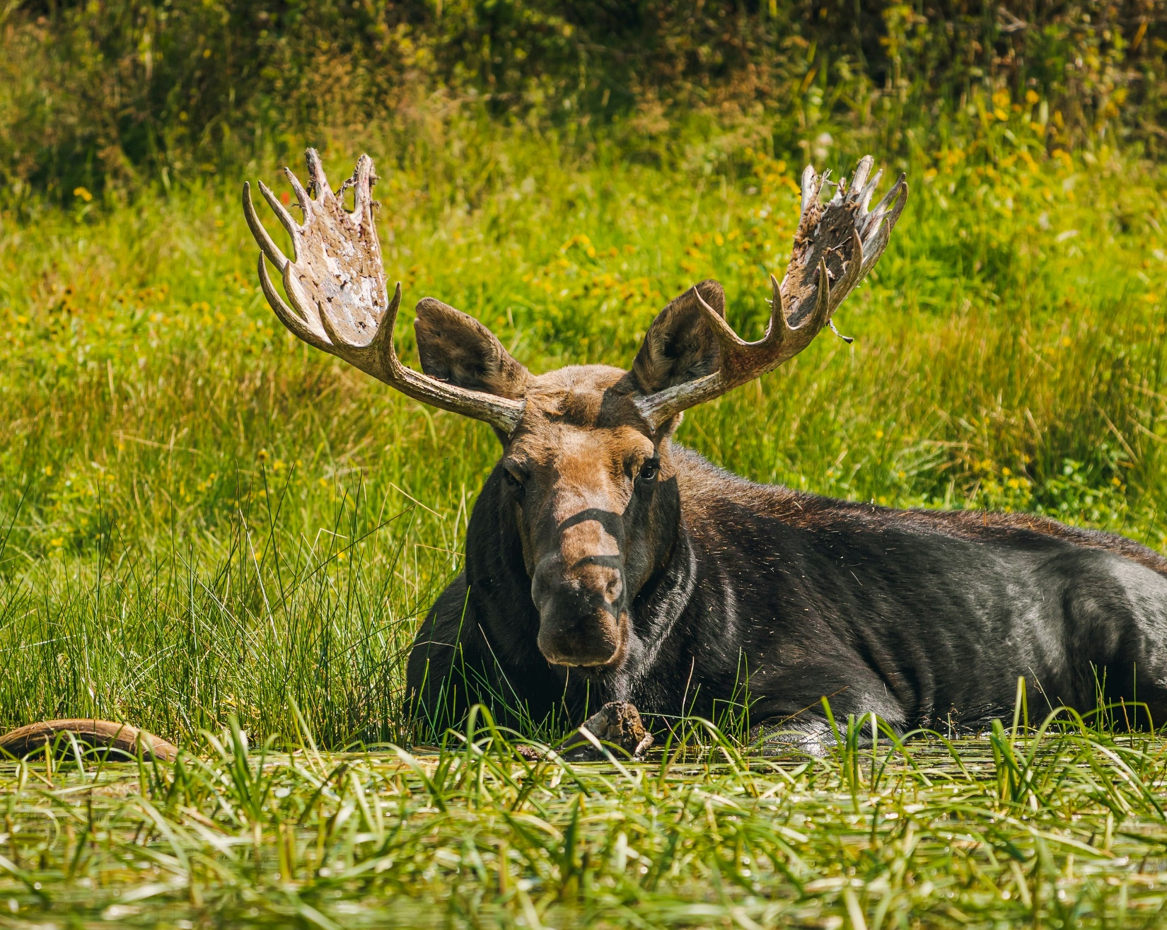
Heat affects mammals’ behavior and fitness
Mammals are sensitive to hyperthermia, especially large ones (Alston et al., 2020)
Excessive heat:
Limits movement rates (Dyer et al. 2023)
Can cause physiological damage (Hetem et al. 2014)
Photo by Jeremy Gerritsen on Unsplash (cropped)

Slide 9






There are many drivers of movement behavior
Notes:
When temperatures are high, mammals will often reduce their movement rates and search for thermal regufia, areas that are buffered from extreme temperatures.
However, mammals’ movement behavior also depends on a series of other drivers, such as…
Temperature, in turn, affects each of these drivers, so it is important to disentangle each of these interactions carefully when estimating the effects of temperature on movement behaviour.

Slide 10
How and where will mammals move in 2100?

Slide 11
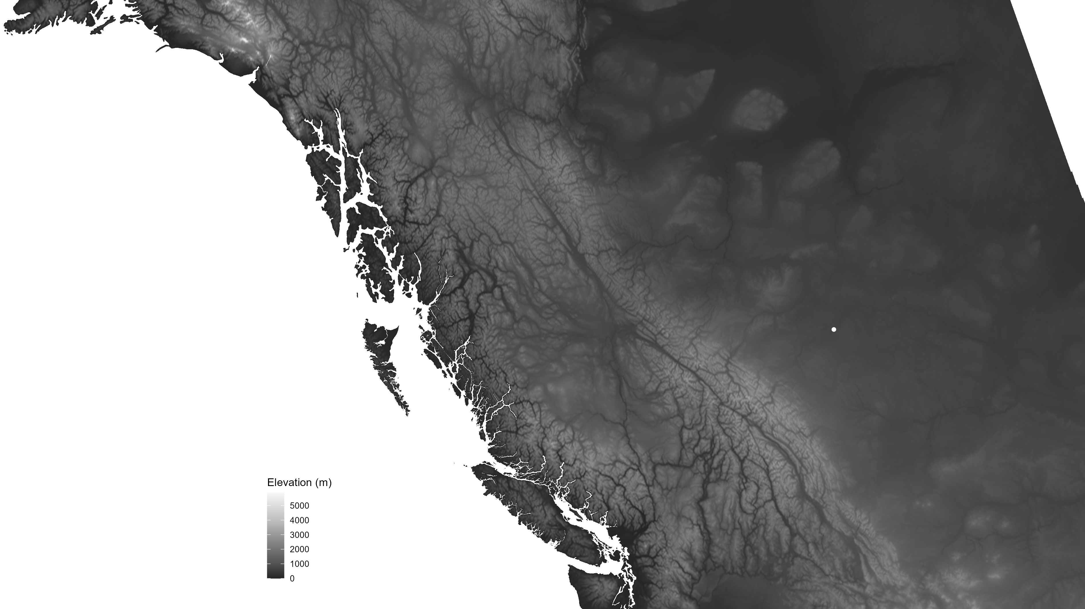
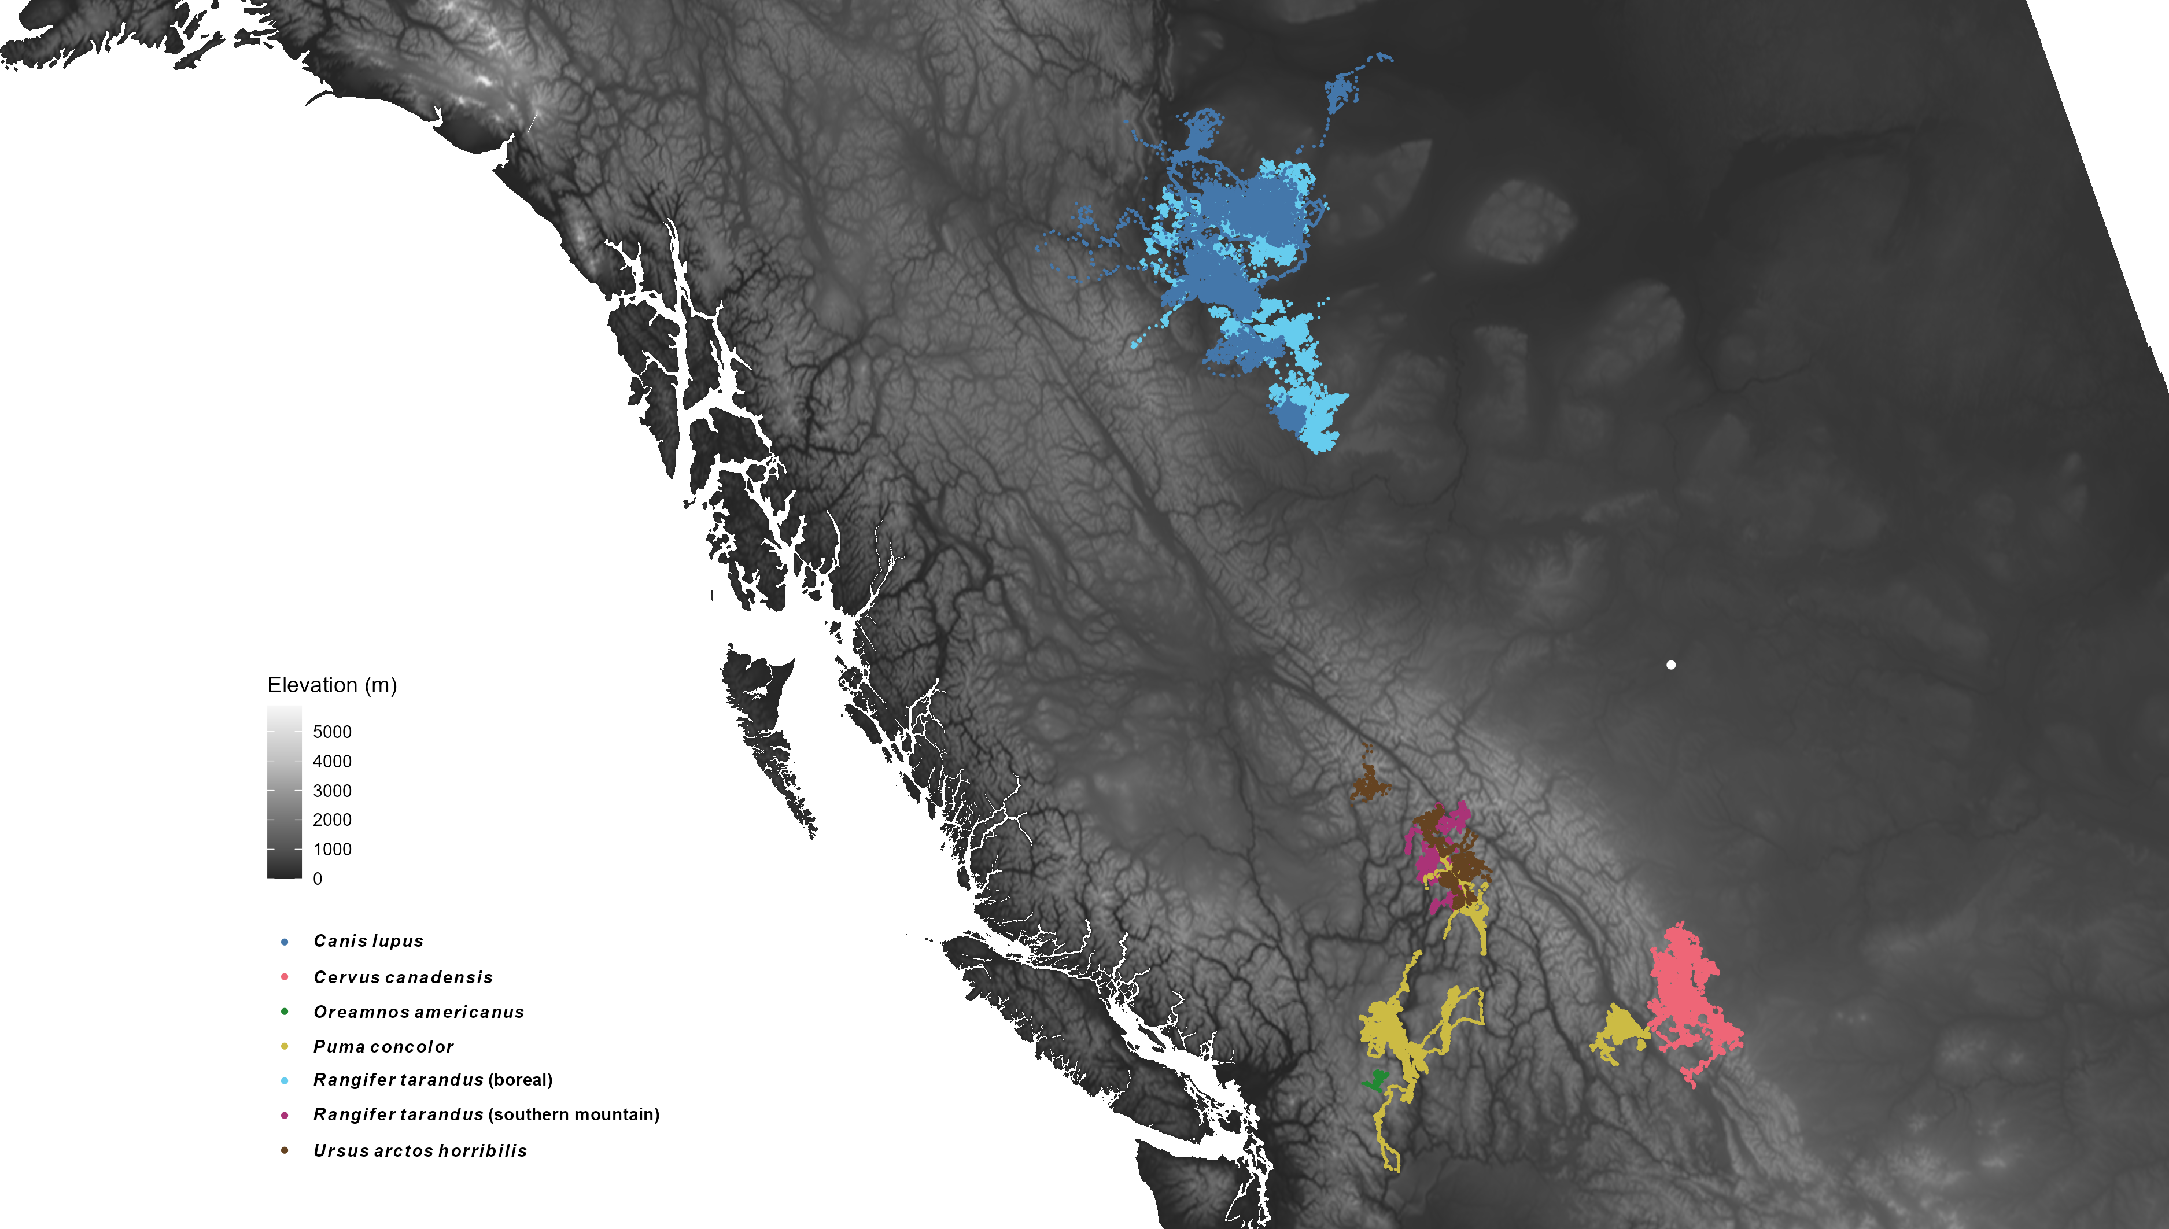
Edmonton
Notes:
I focused on western Canada in part due to its variety of habitats and wide range in elevation.

Slide 12


1.5 million GPS locations
6 mammal species
2 caribou ecotypes
Edmonton
Notes:
Our dataset included 1.5 M GPS locations across 6 mammal species and two different caribou ecotypes.
Specifically, we had data from boreal caribou and wolves, southern mountain caribou, grizzly bears, elk, cougars, and mountain goats from Cathedral Park.

Slide 13
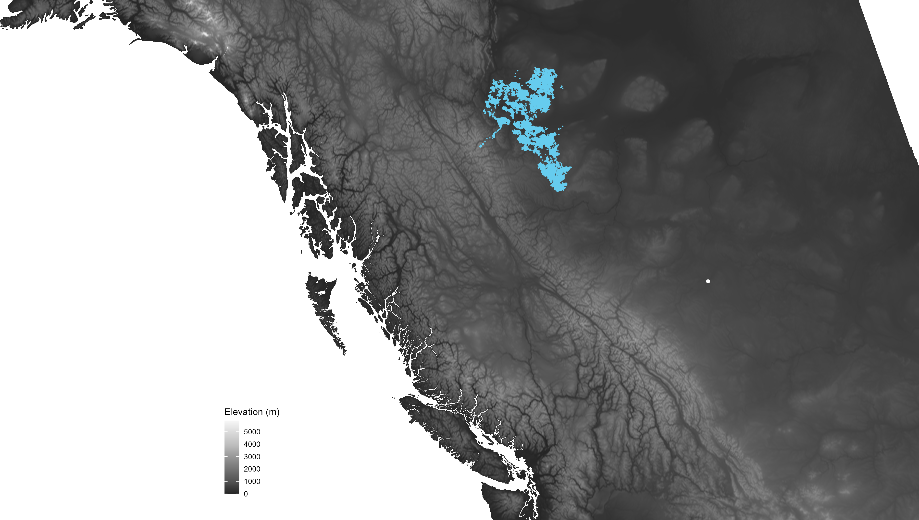
Edmonton

Slide 14
Temperature affects how caribou move

Slide 15

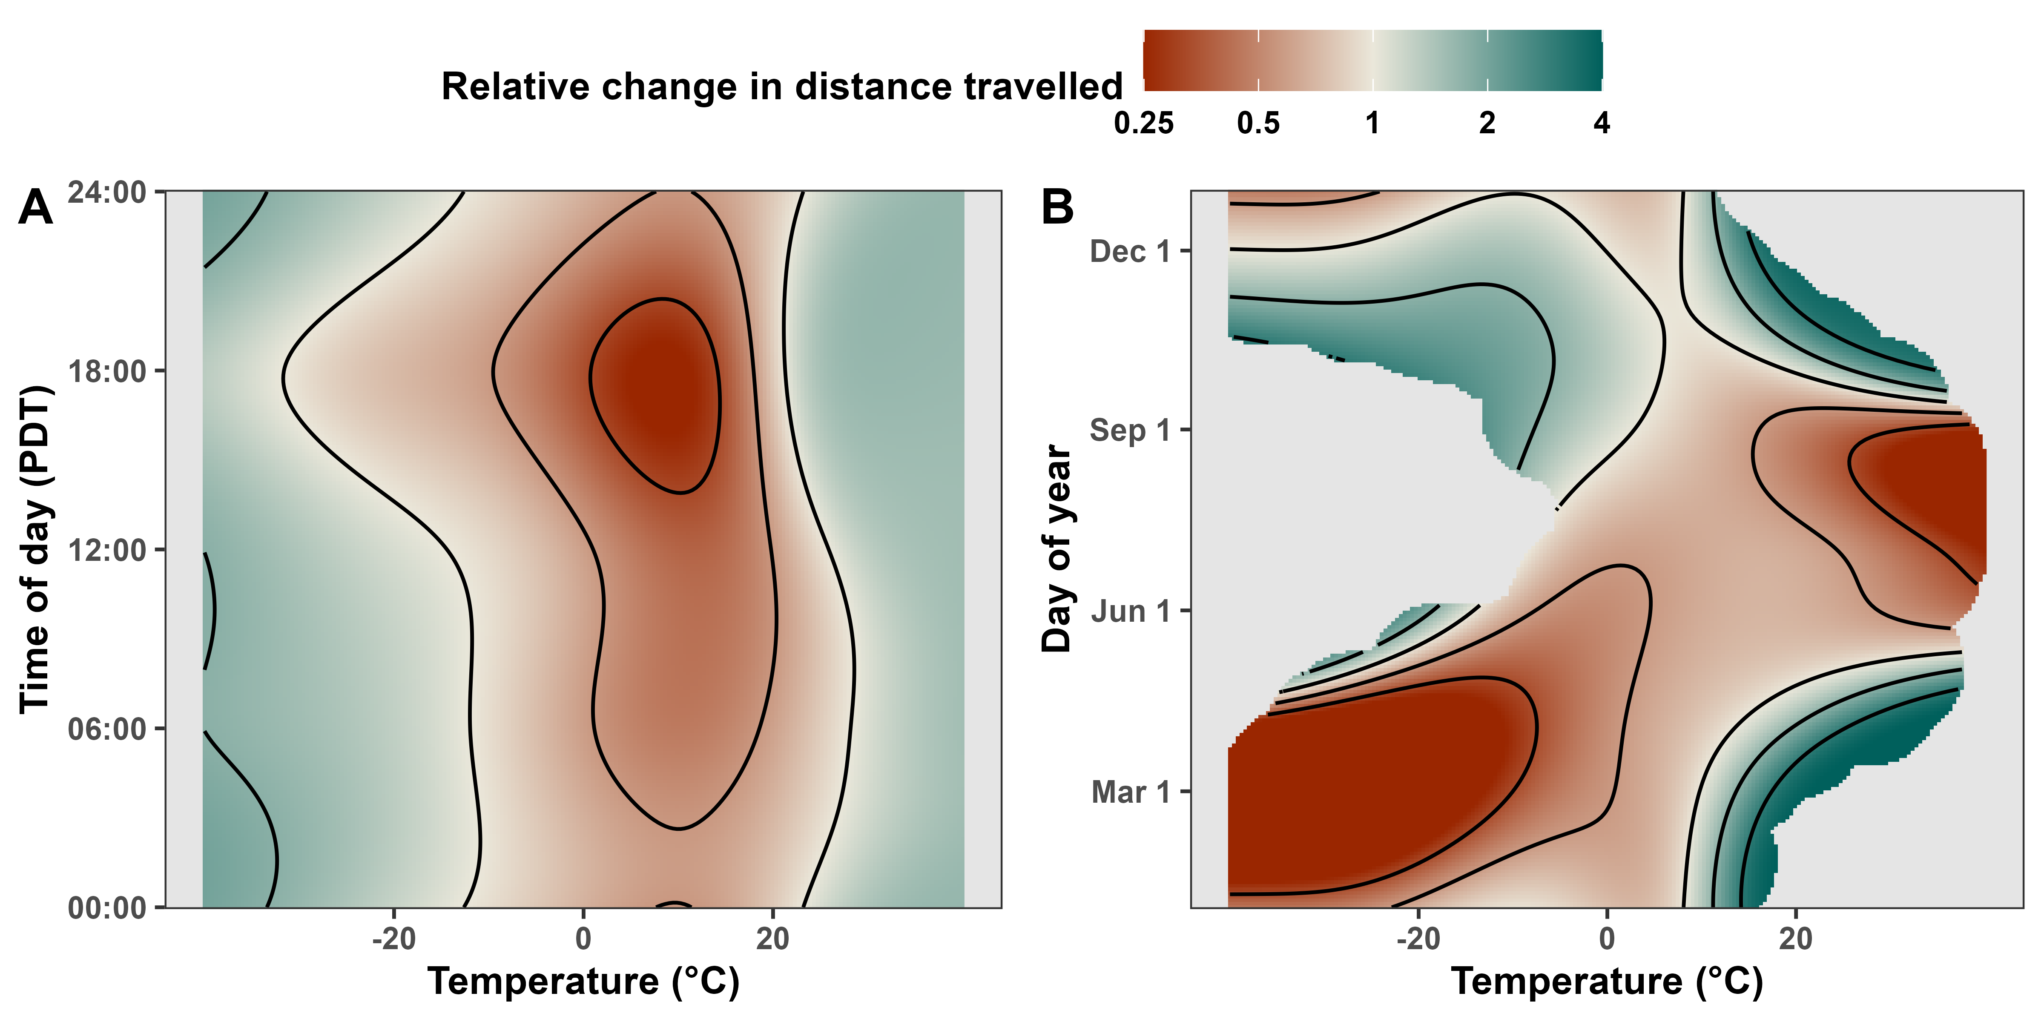
Temperature alters movement phenology
Notes:
These two figures show how boreal caribou altered their movement phenology in response to temperature. Red areas indicate less movement, while green areas indicate more movement. Panel A shows relative change over time of day in early October, while panel B shows changes throughout the year. In panel A, we can see that caribou moved the least when temperatures were between 0 and 20 degrees, and they moved about 4 times as much when temperatures were below minus 20 degrees or above 20 degrees. Seasonally, caribou moved the least on COLD winter and spring days as well as on HOT summer days. They moved the most in fall and on warm winter or spring days.

Slide 16
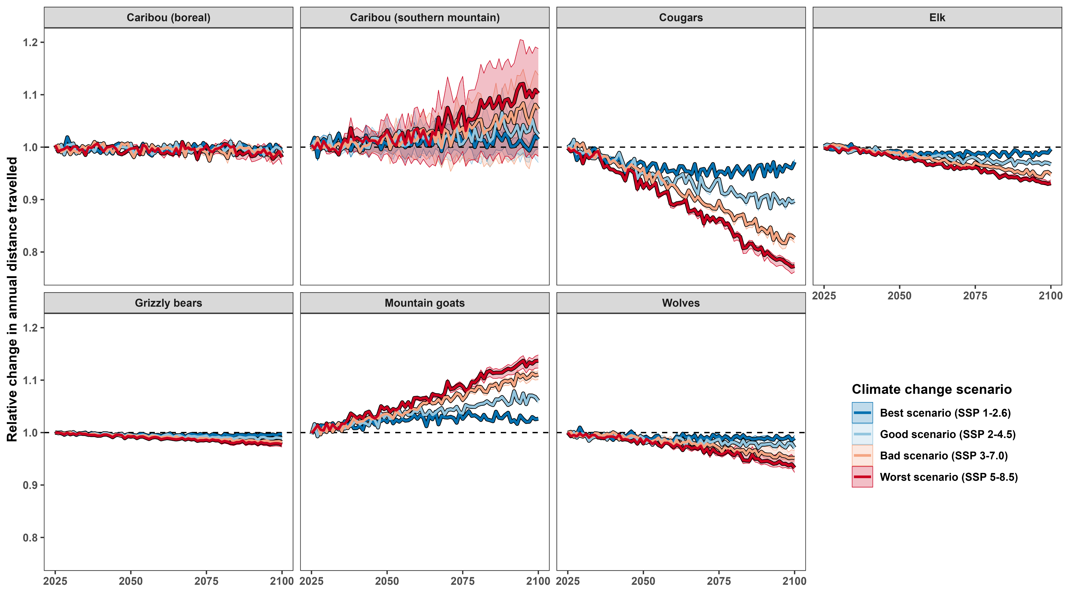





Annual averages may not change much…
Notes:
I then used these estimates to project how boreal caribou will move under different climate change scenarios, but there was no appreciable difference across scenarios. The projected changes under the best-case scenario, in blue, are indistinguishable from those under the worst-case scenario, in red.

Slide 17
… but averages are not representative of extremes
Notes:
However, the projections did not account for daily cycles, and the seasonal trends likely canceled out since heat caused caribou to move less in summer and more in other seasons.

Slide 18
Temperature affects caribou’s habitat selection

Slide 19
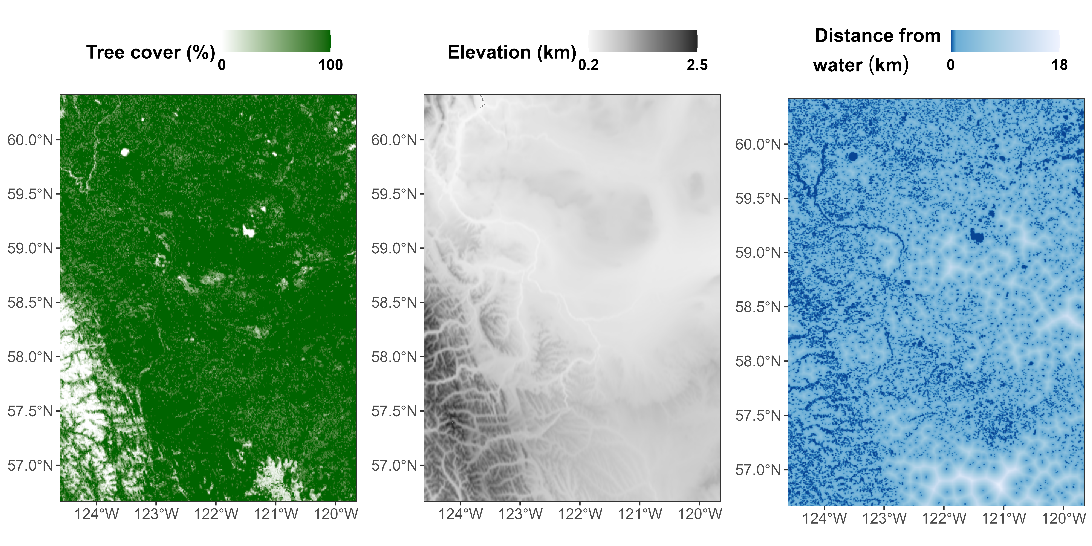
A simple resource selection function

Slide 20


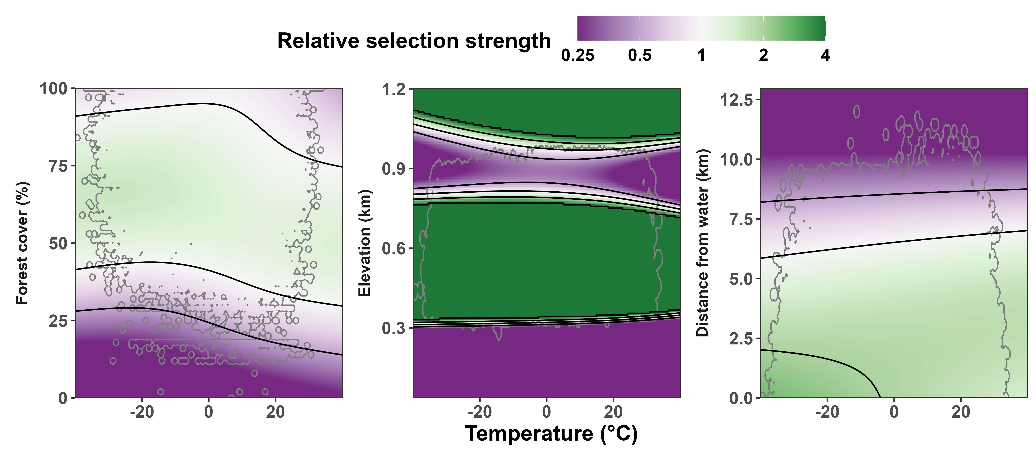
Temperature alters habitat selection
Notes:
In this figure, we can see how temperature affected boreal caribou’s habitat selection, with purple areas indicating avoidance and green indicating attraction.
As temperatures warmed, caribou shifted to less forested areas and were more likely to move up elevationally or away from water.

Slide 21
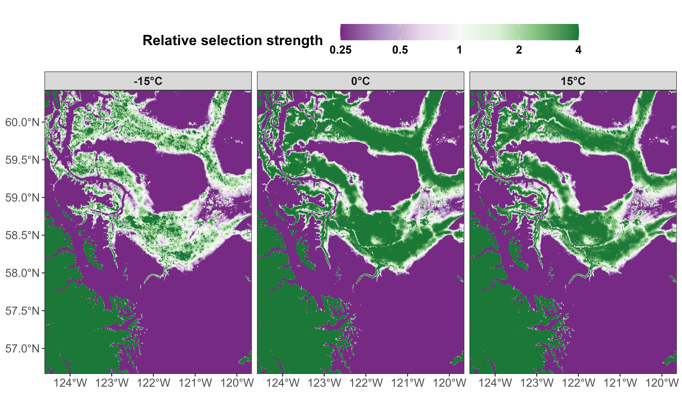


Habitat selection is weaker at extreme temperatures
Notes:
If we apply these models to the caribou’s current range, we can see that their habitat selection is strongest near 0 degrees (in the middle panel), and it is weaker at plus or minus 15 degrees, suggesting that their selection strength weakens at extreme temperatures.

Slide 22
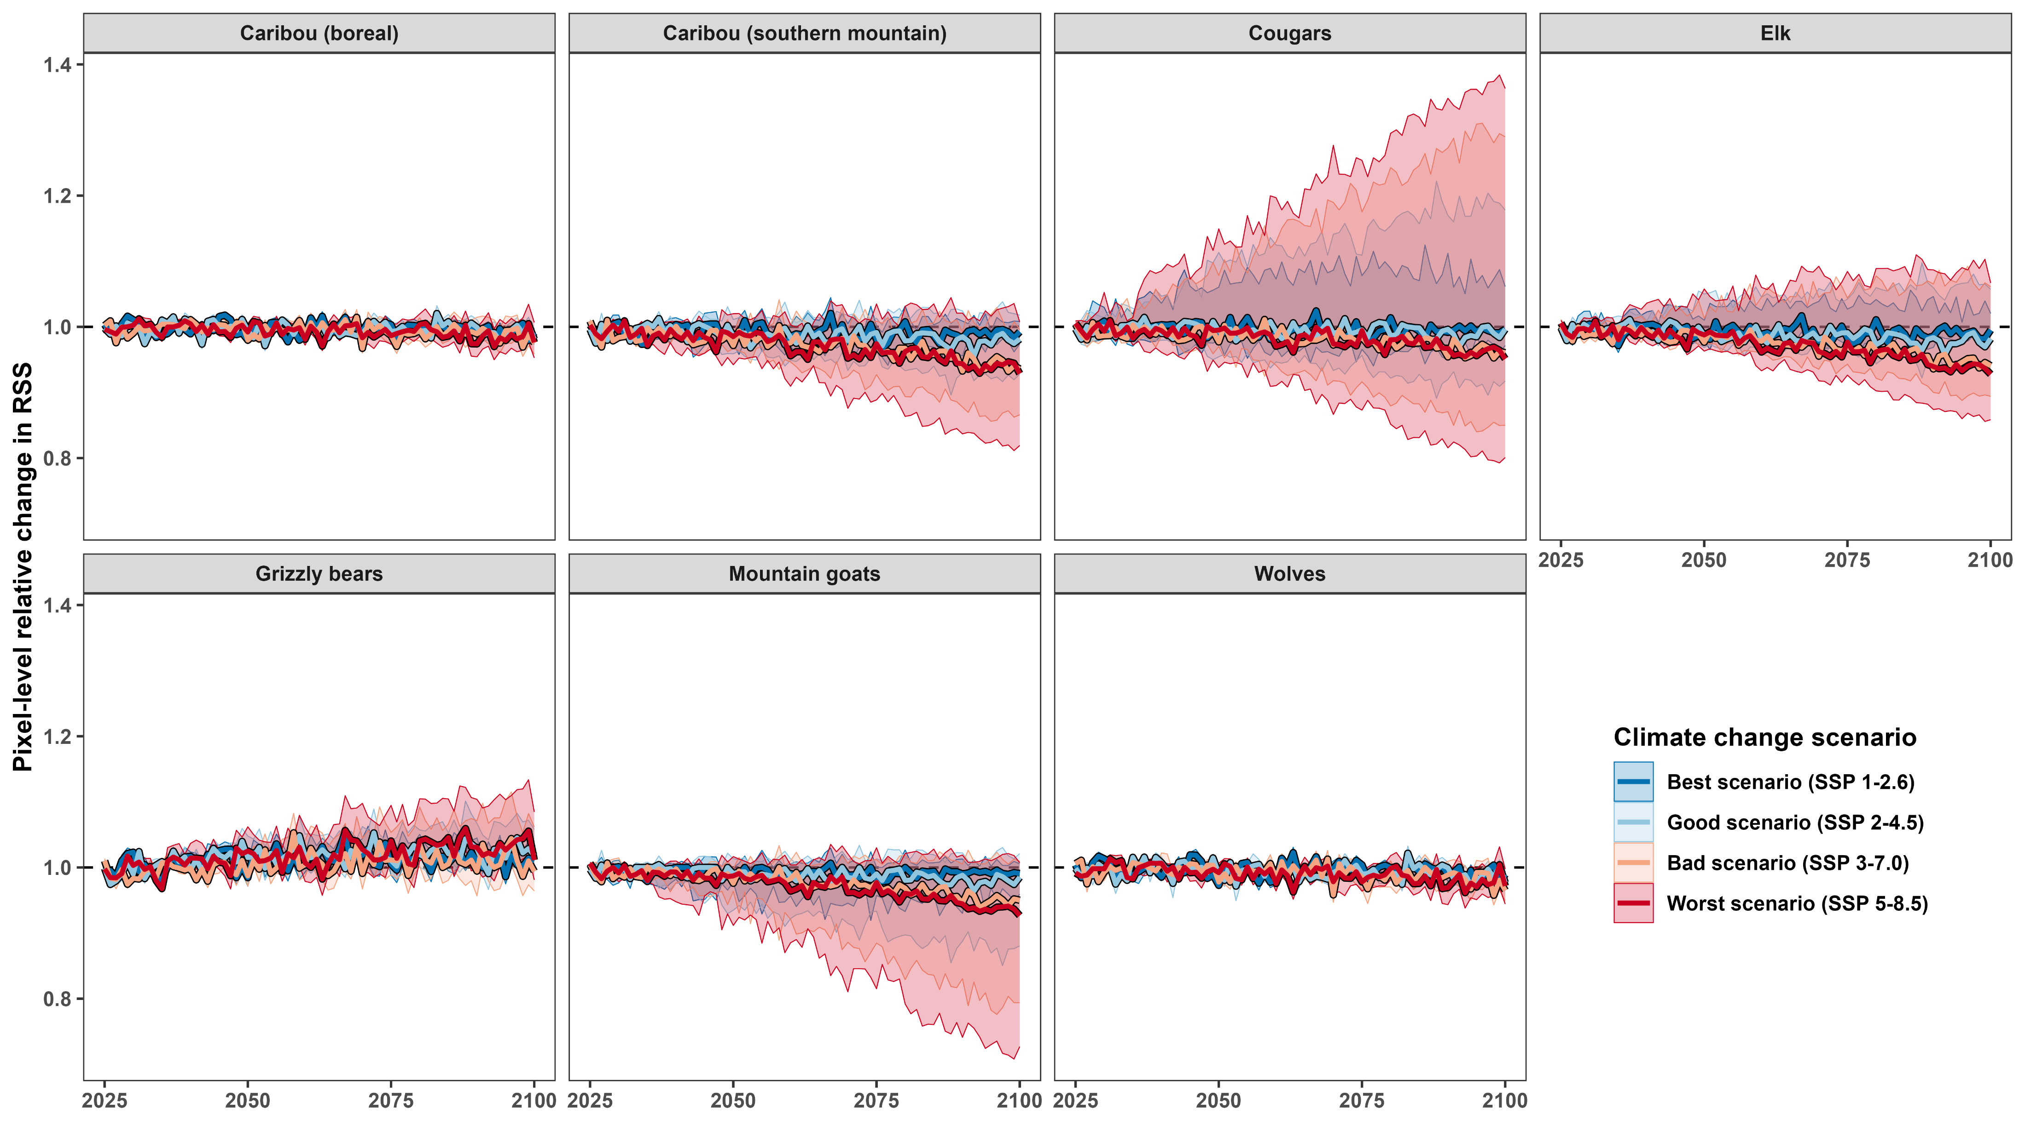

Annual averages may not change much…
Like
Dislike
Notes:
But again, projections of future selection strength did not show much change over the decades, and there are no substantial differences across scenarios. This is likely in part because of the weaker selection at extreme temperatures, since yearly averages do not show the seasonal variation in habitat selection. Still, something interesting appears if we focus specifically on the predictions for 2100.

Slide 23
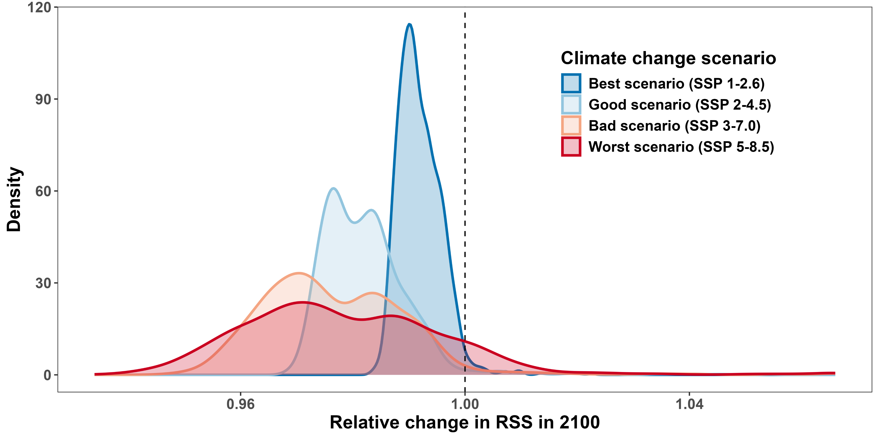
Worse scenarios result in wider range of RSS
Notes:
Under worse scenarios, we see not only a decrease in average selection strength, but also a widening of the distribution. This suggests that caribou may be forced to traverse patches they would generally avoid as they travel to high-selection patches, or that they may face stronger seasonal fluctuations in habitat selection.

Slide 24
Predators also affect movement behavior
Notes:
So far, we’ve looked at how resources, phenology, and temperature impact boreal caribou’s movement behavior. However, their movement also depends on that of their predators, which, in turn, also depends on temperature.

Slide 25
Edmonton
Notes:
While I did not look at predator-prey interactions specifically, we can look at how temperature affected boreal wolves’ movement behavior to start formulating some some hypotheses.

Slide 26
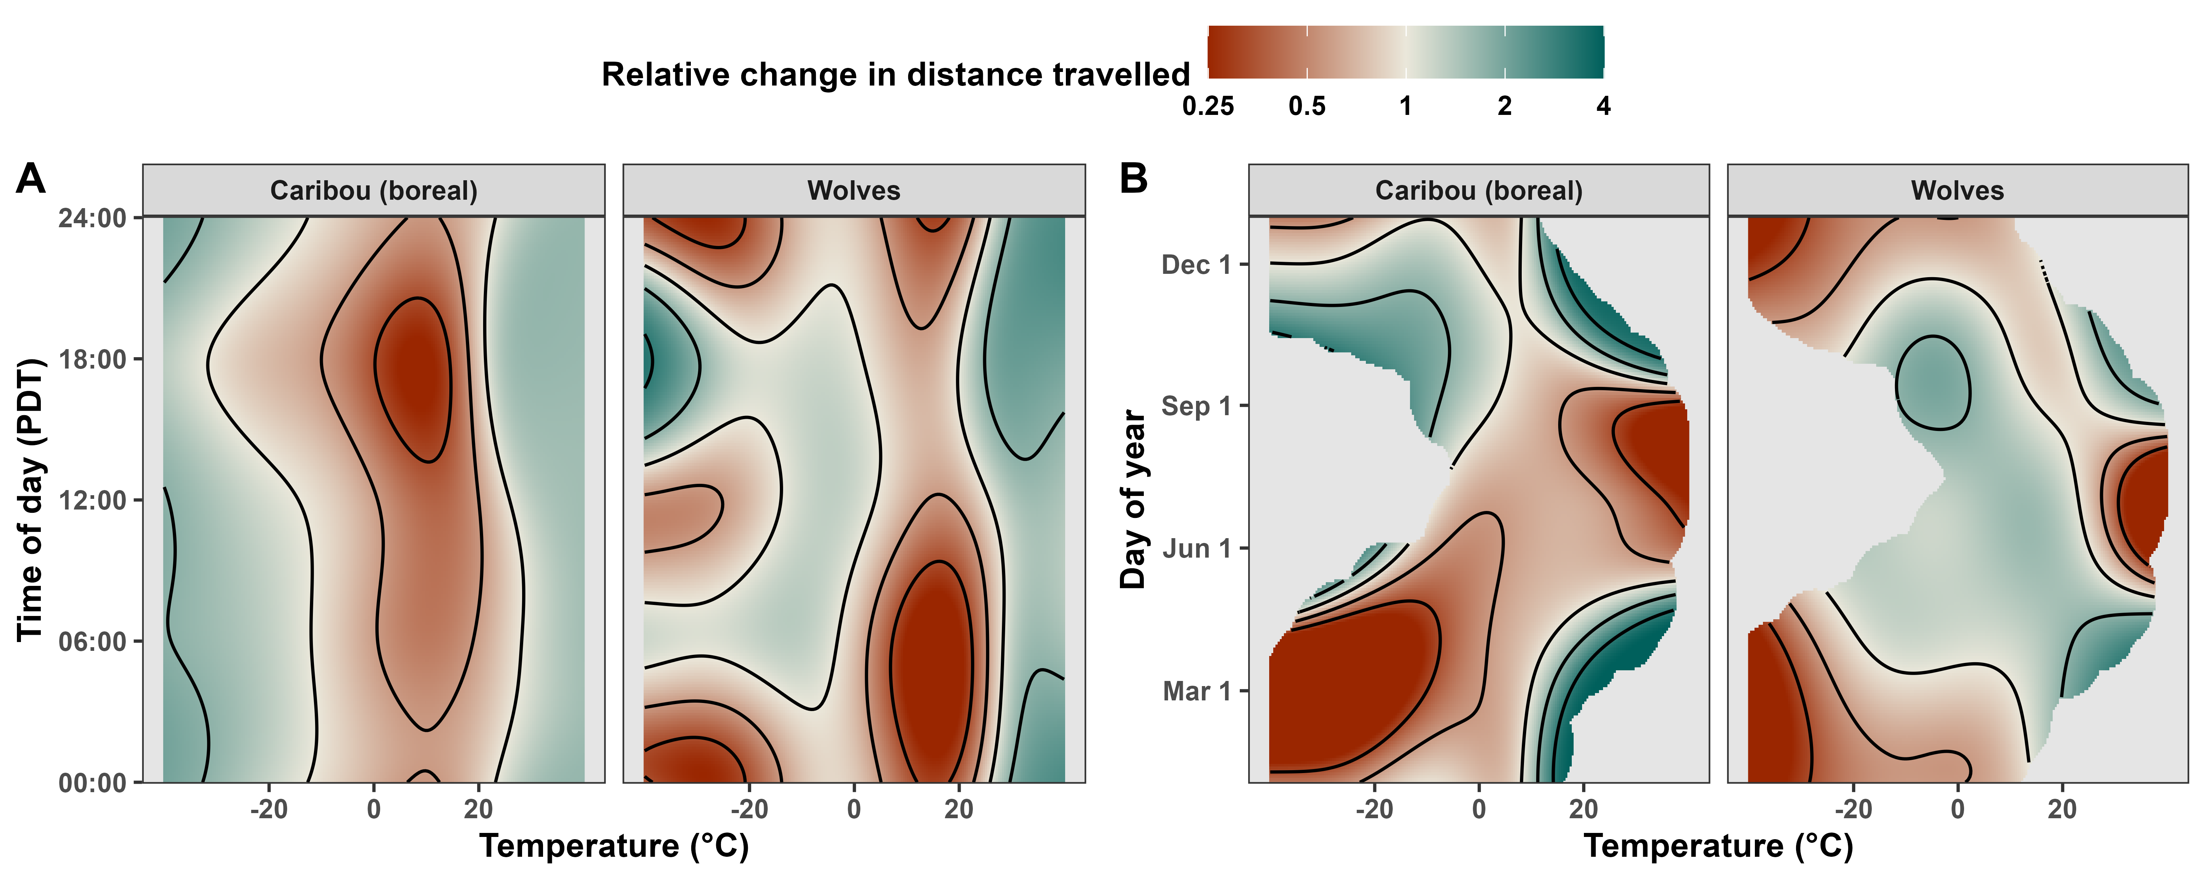
Wolves respond to heat similarly to caribou
Notes:
Overall, wolves adapted their movement rates to temperature similarly to caribou. Generally, they moved the least between 0 and 20 degrees and more above 20 degrees, except in summer, when hot temperatures caused them to move less.

Slide 27
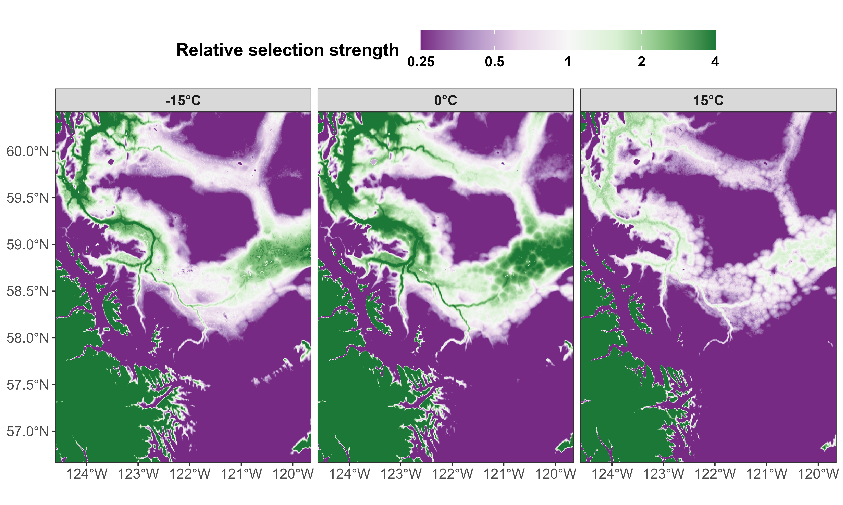
Habitat selection depends on temperature
Notes:
As with caribou, habitat selection for wolves’ main range was highest near 0 degrees and lower at colder or hotter temperatures. However, unlike caribou, wolves showed a strong selection for water, particularly at or below 0 degrees. We can see this most clearly in the middle panel, where the entire river system is a dark green.

Slide 28
Encounter rates depend on temperature
Caribou avoid wolf habitat
Lower RSS at extreme temperatures:
Hot summers = lower risk?
Warm winters = higher risk?
Notes:
If we compare the two figures side by side, we can clearly see that both species occur in similar ranges, but caribou tend to avoid the river system where wolves are often found. Thus, wolves spend more time in areas caribou tend to avoid, but they also often move across caribou habitat. Since both broaden their habitat selection at extreme temperatures, we may expect encounter rates to decrease during hot summers. However, warmer winters would likely result in an increase in encounter rates as temperatures move towards zero degrees and both species increase their selection strength.

Slide 29
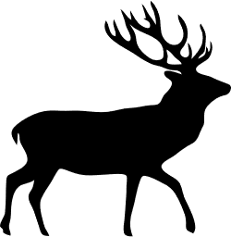
Species adapt their movement rates differently
Notes:
And while I also have results for each of the other species, I unfortunately don’t have the time to cover each of them individually, since there were no common trends across all groups.
So here are a two honorable mentions.
Number one: Cougars’ sensitivity to temperature varied smoothly with the seasons, such that relatively hotter temperatures reduced their movement rates, regardless of the season.
Number two: Grizzly bears showed lower movement rates shortly before or after hibernation and moved the most in summer, but warmer temperatures resulted in less movement in fall.

Slide 30
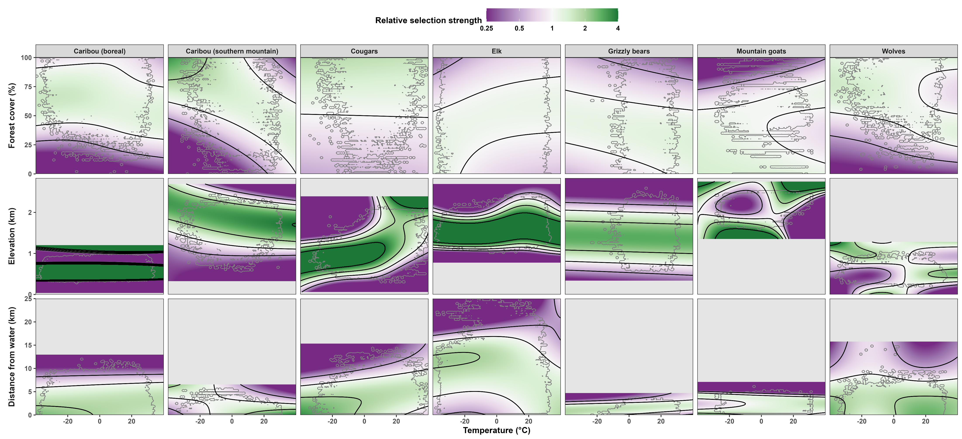
Species alter their habitat selection differently
Notes:
With respect to resource selection strength, there were again no common trends across all species. At warmer temperatures, some moved towards tree cover while others moved away from it; some shifted up elevationally while others moved downwards; some avoided water, while others were drawn to it. However, these estimates should be interpreted carefully, since all three variables are somewhat correlated.

Slide 31

Species will adapt their movement rates differently
Notes:
And while there is substantial variation across species’ responses, we do see some common trends in our climate change projections. Bold lines indicate the projected median change in distance traveled throughout the years, while the transparent ribbons show the range between the top 5% and bottom 5% change within each species’ range. On average, boreal caribou and grizzly bears are predicted to move approximately the same distance throughout the year, while SOUTHERN MOUNTAIN caribou and mountain goats are expected to travel longer distances, and cougars, elk, and wolves are expected to move less. Overall, worse climate change scenarios always resulted in more severe changes.

Slide 32
Species will adapt their habitat selection differently
Notes:
We also found common trends in our projections for habitat selection strength.
Boreal caribou, grizzly bears, and wolves are not projected to alter their selection strength substantially, while SOUTHERN MOUNTAIN caribou and mountain goats are expected to show widespread decreases.
Cougars and elk are projected to show decreases in median selection strength along with stronger selection for some parts of their habitats.

Slide 33
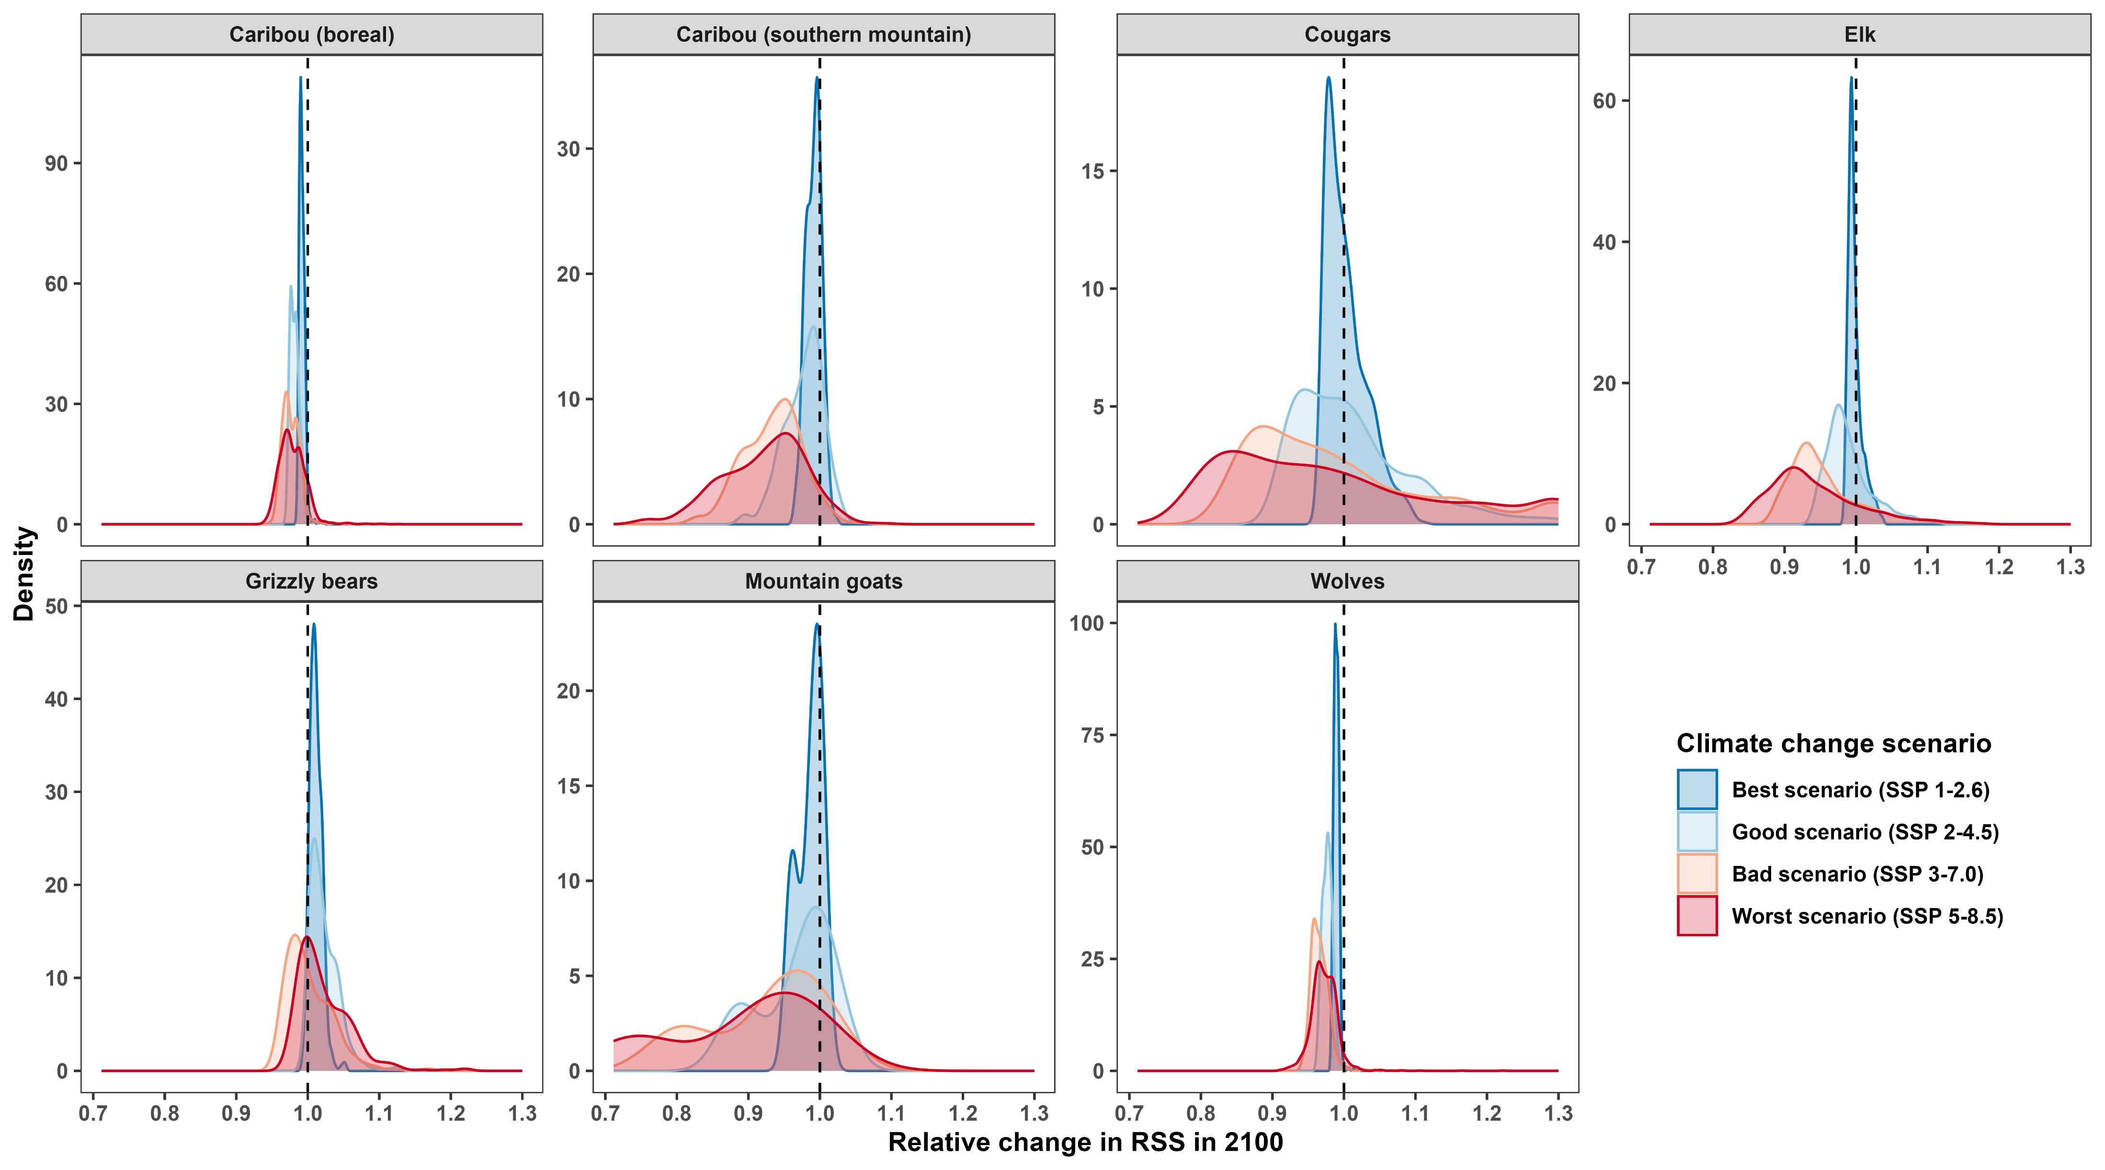
Worse scenarios ==> stronger preferences
Notes:
Again, if we focus only on the change in selection strength in 2100, we can see that, for all species, worse scenarios are expected to result in wider ranges of selection for and against habitats, although the trend is most visible for southern mountain caribou, cougars, elk, and mountain goats. As the climate warms, these species will likely shift their range or be forced to live in a habitat they would prefer to avoid.

Slide 34
Effective conservation will require proactive action
Predicting the future using historical data is hard:
Mammals’ responses to temperature are nonlinear
Data at extreme temperatures are scarce
We need to protect habitats proactively:
Animals may start selecting against current habitats
Should account for future changes when protecting areas
Notes:
Effective conservation will therefore require careful, proactive action. Predicting future behaviours is a major challenge, since mammals’ responses to temperature are nonlinear and data at extreme temperatures are scarce.
However, for protected areas to be effective, we NEED to start protecting habitats proactively. In the future, animals may select AGAINST regions that they currently select for, so we must account for future changes when designating areas for long-term conservation.

Slide 35



Summary and future directions
Manuscript in preparation
Temperature has nonlinear effects on mammals’:
Movement rates
Habitat selection
Mitigating effects of climate change requires proactive action:
Movement behavior will change
Landscape dynamics will change
More work needed on effects of temperature on:
Underrepresented species, e.g., small mammals
Species-specific effects and interactions between species
GitHub Repo
Notes:
In summary, temperature has nonlinear and complex effects on mammals’ movement rates and habitat selection, with effects cascading to the community level. Mitigating the effects of climate change will require careful and proactive action that accounts for changes in species’ movement behavior as well as changes in landscape dynamics.
More work is needed on quantifying the effects of climate change on underrepresented species, such as small mammals, and future work should develop more species-specific models that explicitly account for interactions between species, such as predator-prey interactions.
For those interested in learning more, I have included QR codes that link to the manuscript I am writing with my coauthors as well as the GitHub repo with all my code.

Slide 36







Notes:
And with that, I thank you for listening, and I would like to also thank all those who funded and supported this research.

Slide 37
References and credits
Alston JM, Joyce MJ, Merkle JA, Moen RA (2020) Temperature shapes movement and habitat selection by a heat-sensitive ungulate. Landscape Ecology, 35, 1961–1973.
Dyer A, Brose U, Berti E, Rosenbaum B, Hirt MR (2023) The travel speeds of large animals are limited by their heat-dissipation capacities (ed Hedenström A). PLOS Biology, 21, e3001820.
Hetem RS, Fuller A, Maloney SK, Mitchell D (2014) Responses of large mammals to climate change. Temperature, 1, 115–127.
Polazzo F, Limberger R, Pennekamp F, Ross SRP‐J, Simpson GL, Petchey OL (2024) Measuring the Response Diversity of Ecological Communities Experiencing Multifarious Environmental Change. Global Change Biology, 30, e17594.
Cougar phylopic: CC BY-NC 3.0: Cristian Osorio & Paula Carrera, Proyecto Carnivoros Australes
Mountain goat phylopic: CC-BY-SA 3.0: Sarah E. Haworth
R code can be found at https://github.com/QuantitativeEcologyLab/bc-mammals-temperature

Slide 38
Summary and future directions
Manuscript in preparation
Temperature has nonlinear effects on mammals’:
Movement rates
Habitat selection
Mitigating effects of climate change requires proactive action:
Movement behavior will change
Landscape dynamics will change
More work needed on effects of temperature on:
Underrepresented species, e.g., small mammals
Species-specific effects and interactions between species
GitHub Repo
Notes:
In summary, temperature has nonlinear and complex effects on mammals’ movement rates and habitat selection, with effects cascading to the community level. Mitigating the effects of climate change will require careful and proactive action that accounts for changes in species’ movement behavior as well as changes in landscape dynamics.
More work is needed on quantifying the effects of climate change on underrepresented species, such as small mammals, and future work should develop more species-specific models that explicitly account for interactions between species, such as predator-prey interactions.
For those interested in learning more, I have included QR codes that link to the manuscript I am writing with my coauthors as well as the GitHub repo with all my code.

